Slide 1
Patient priority system
Using C and Data Structures
Team Details:
A. Sai lokesh – 24KB1A0501 – Team lead
B. Purna Charan – 24KB1A0532
B. Surendra – 24KB1A0544
D. Jaswanth – 24KB1A05D7

Slide 2
Introduction
Description: The Patient Queue System is a priority-based patient management system that allows appointment of patients based on their priority. This system helps in efficiently managing patients' treatment based on their urgency.
Key features:
1) Input for patient’s name, age, case type, and priority.
2) Patients are treated in the order of their priority.
3) The system uses a linked list to maintain the patient queue.

Slide 3
Objective
To develop a priority queue system for managing patient appointments and treatments.
To learn and implement data structures like linked lists in C.
To understand how a priority queue operates, especially in the context of healthcare environment.

Slide 4
Why C, DS?
Why C:
C is a low-level language that provides more control over memory management.
It’s efficient in handling large amounts of data and has widespread use in systems programming.
Why DS(Data Structures):
Data Structures like linked list are optimal for maintaining dynamic data, such as patient queue.
Implementing algorithm like insertion in a priority queue helps understand how a data is managed based on specific rules (priority in this case).
DS helps in optimizing the performance and memory usage of the application.

Slide 5
Algorithm
Step 1: Start
Step 2: Main Menu Logic
Declare an integer variable choice.
Repeat until choice ==4 :
Display name:
Appoint Patient
Treat Patient
Display Records
Exit
Read choice.
Perform based on choice:
If choice == 1, call appoint_patient().
Else if choice == 2, call treat_patient().
Else if choice ==3, call diplay_records().
Else if choice ==4, display exit message.
Else, display “Invalid choice”.

Slide 6
Algorithm
Step 3: Appoint Patient
Create a new node.
Read patient’s name, age, case type, and priority.
Set new_node->next = NULL.
If queue is empty OR new_node->priority is higher (i.e., lower number) than head.
Insert new_node at the beginning.
Else:
Traverse the list to find correct position based on priority.
Insert new_node after appropriate node.
Display “Patient Appointed Successfully”.

Slide 7
Algorithm
Step 4: Treat patient
If queue is empty:
Display “No patients to treate”.
Else:
Remove the patient at the front.
Display patient’s details.
Free the memory of the treated patient.
Display “Patient treatement complete”.

Slide 8
Algorithm
Step 5: Display Records
If queue is empty:
Display “No patients appointed”.
Else:
Traverse from head node.
Display all patient’s details one by one.
Step 6: End

Slide 9
Lessons learned
Memory management: Gained hands-on experience with dynamic memory allocation and deallocation using malloc() and free().
Data Structures: Learned how to implement and manipulate linked lists in C, which is a fundamental concept in data structures.
Input Handling: Worked with scanf() to handle user input and ensure proper data entry.
Priority Queue Logic: Understood the importance of priority-based systems and how to maintain ordered data in a queue.

Slide 10
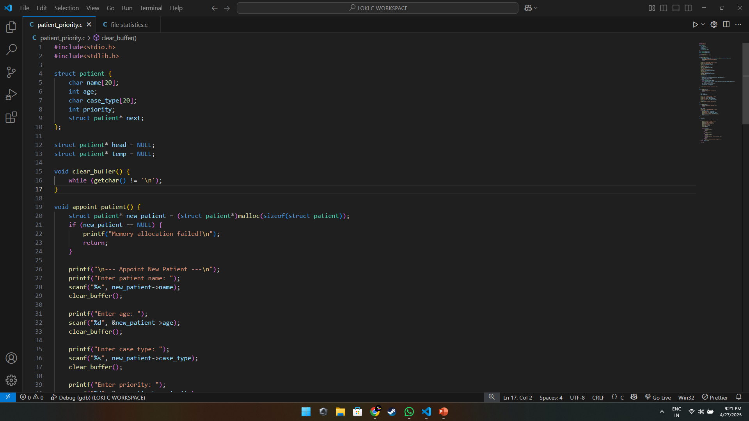
Images

Slide 11
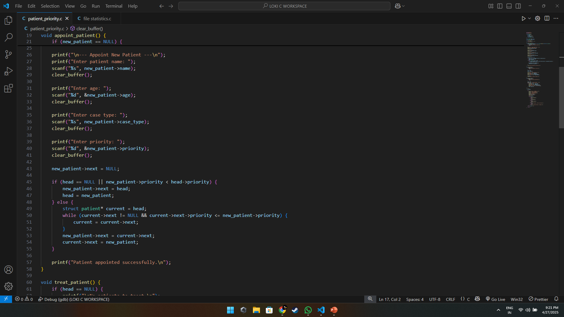
Images

Slide 12
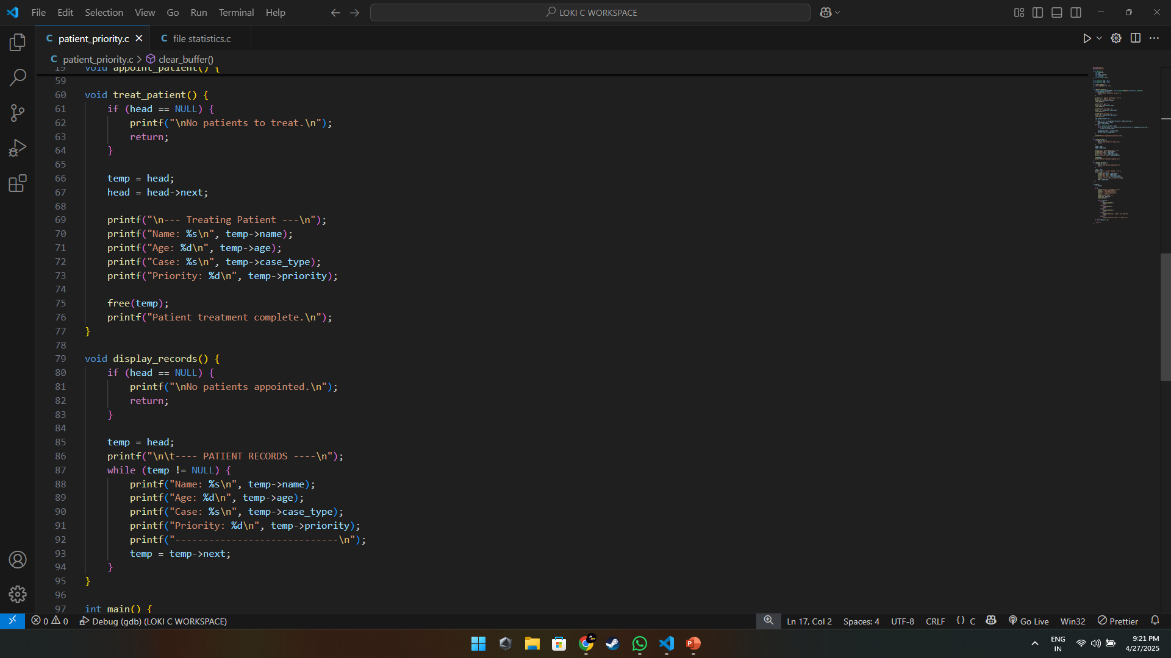
Images

Slide 13
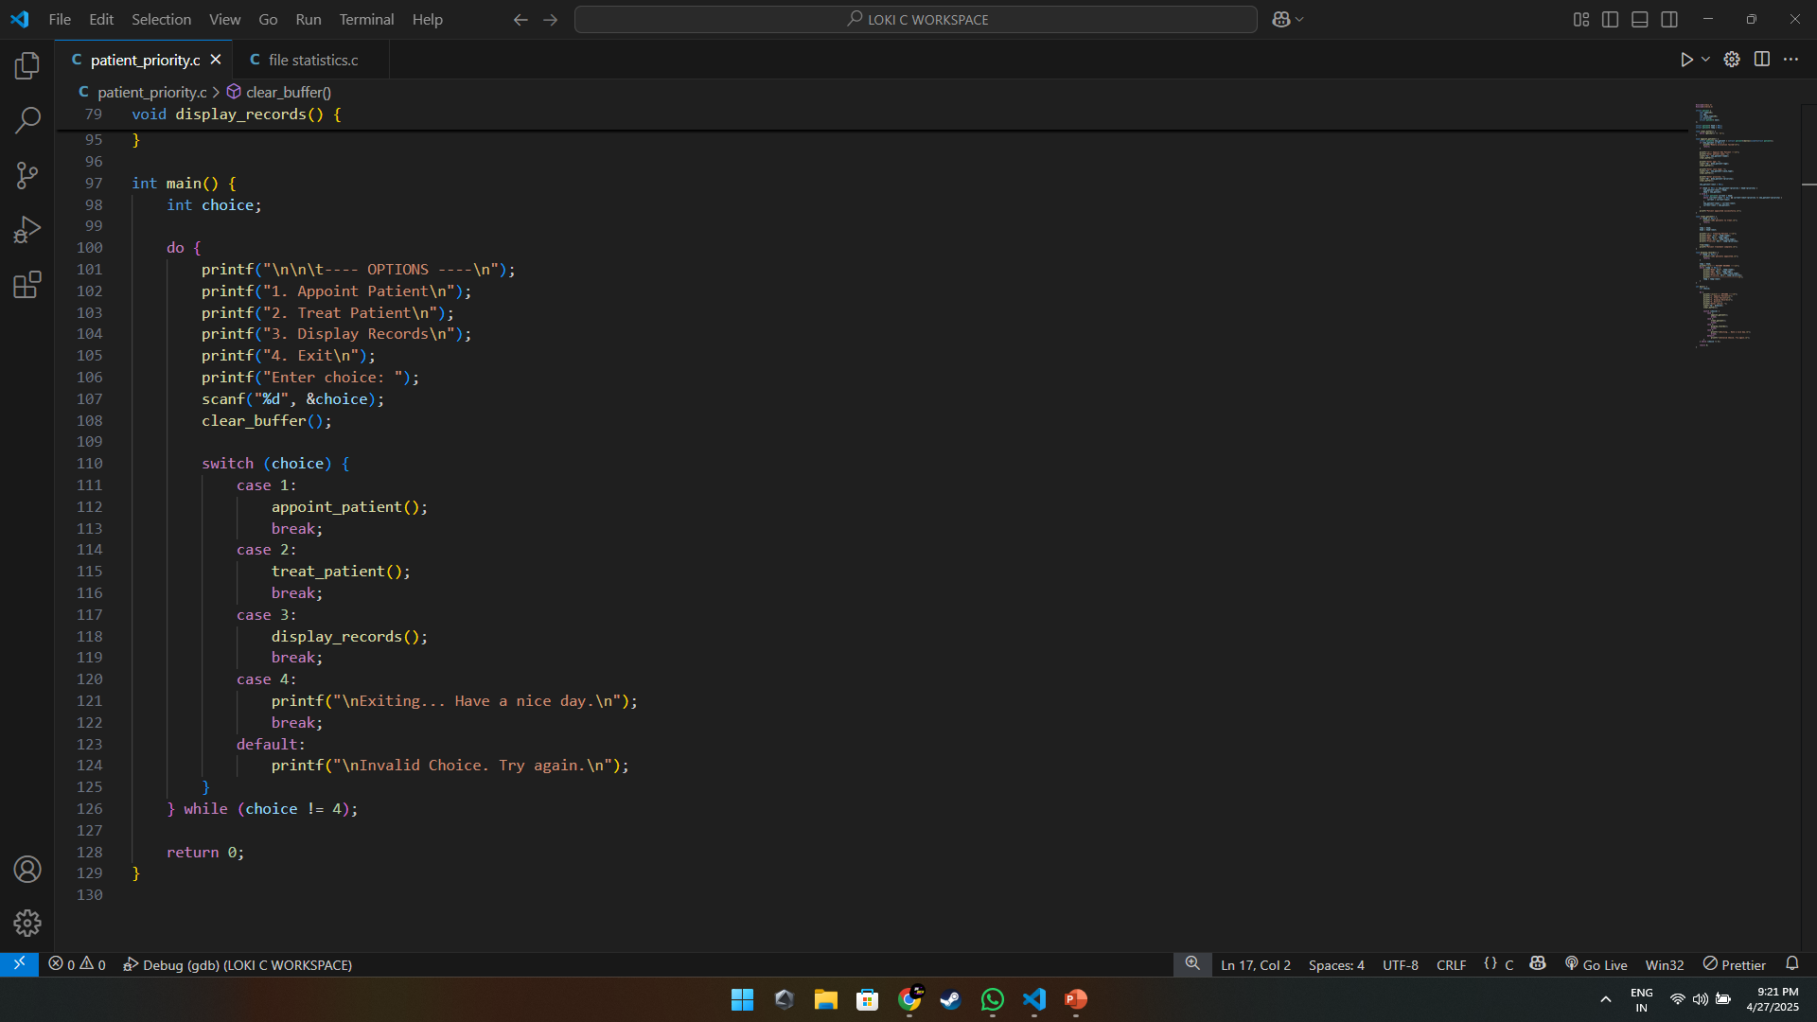
Images

Slide 14
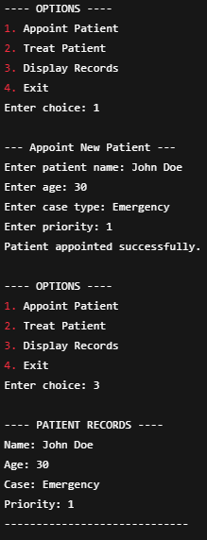
Output
Example Output:

Slide 15
Conclusion
We successfully implemented a real-world patient queue system, strengthening our skills in C programming, linked lists, and problem-solving.
Thank you!
Grateful for your time and attention.

